Slide 1
Model Interpretability

Slide 2
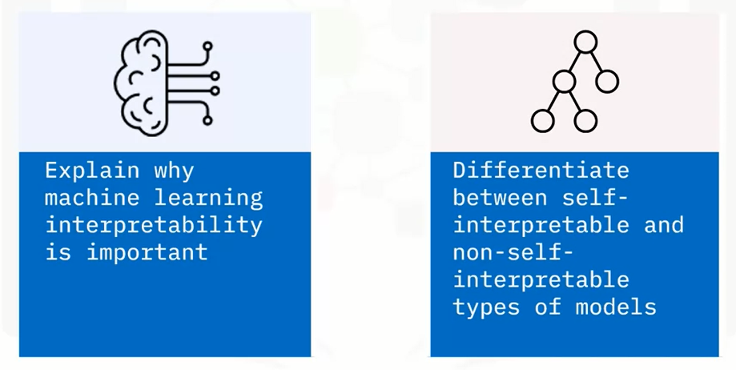
What you will learn

Slide 3
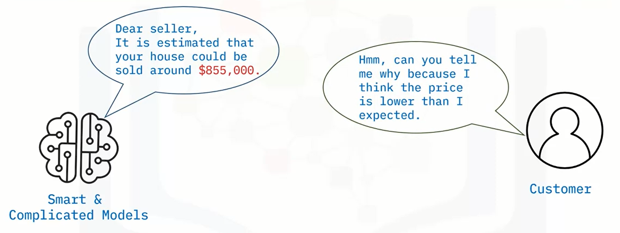
Importance of model interpretability

Slide 4
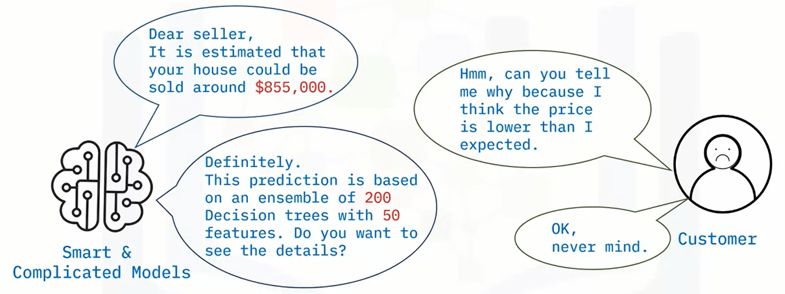
Importance of model interpretability

Slide 5
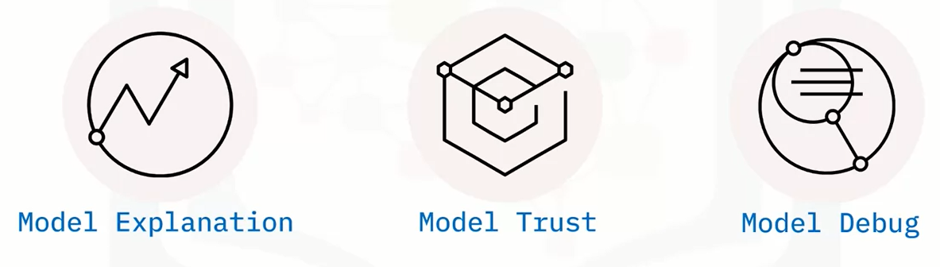
Understanding machine learning models

Slide 6
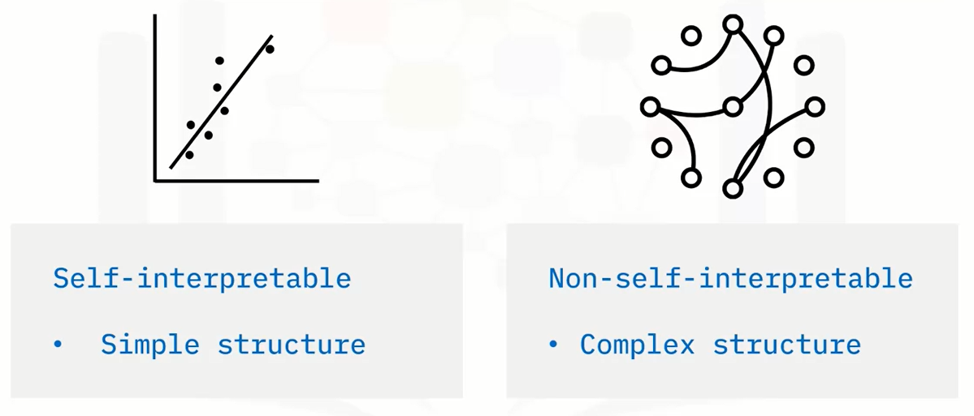
Model interpretability

Slide 7
Recap
In this video, you learned that:
• We can only trust and effectively debug machine learning models if they are understandable
• Self-interpretable models have simple and intuitive structures
• Non-self-interpretable models have complex structures and can be described as black-box models

Slide 8
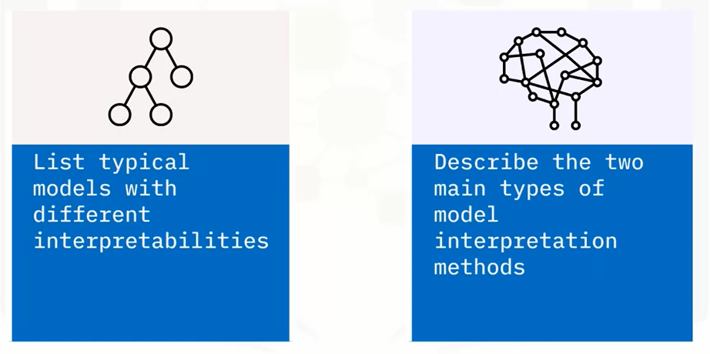
What you will learn

Slide 9
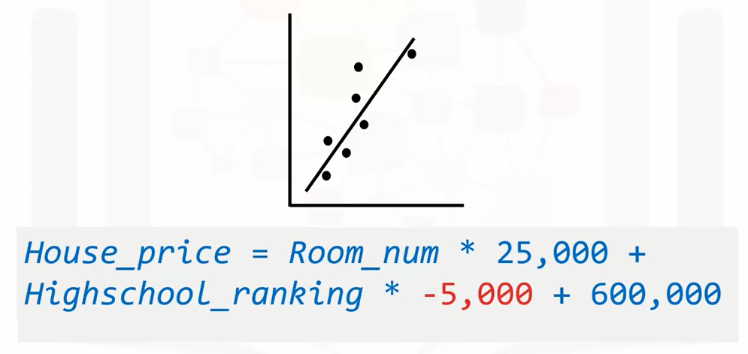
Self-interpretable: Linear models

Slide 10
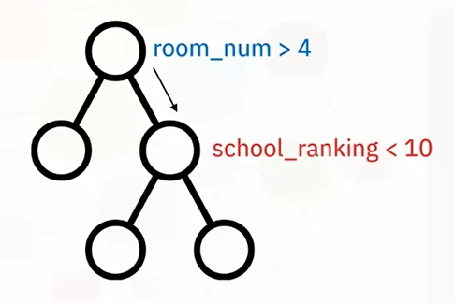
Self-interpretable: Tree models

Slide 11
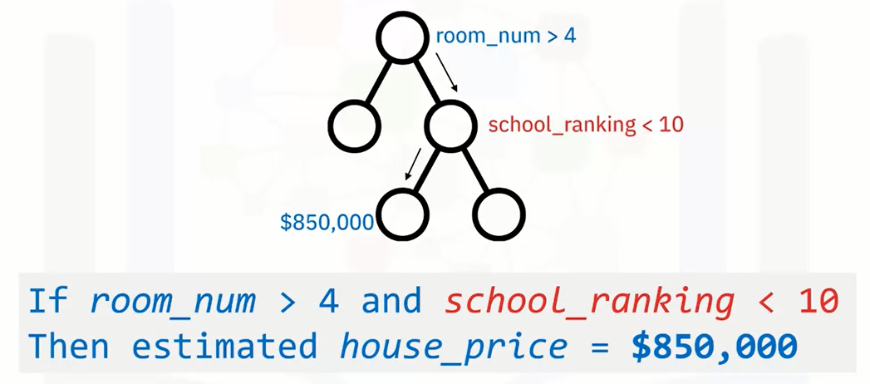
Self-interpretable: Tree models

Slide 12
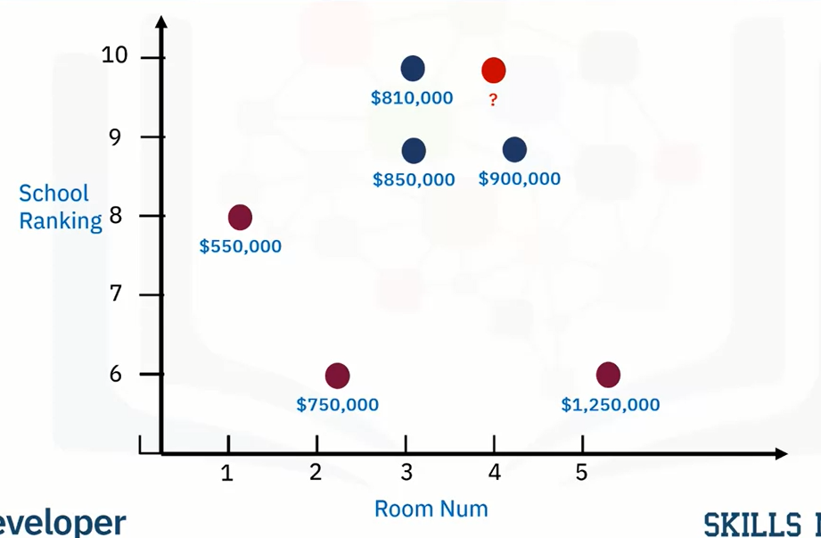
Self-interpretable: K-nearest neighbor

Slide 13
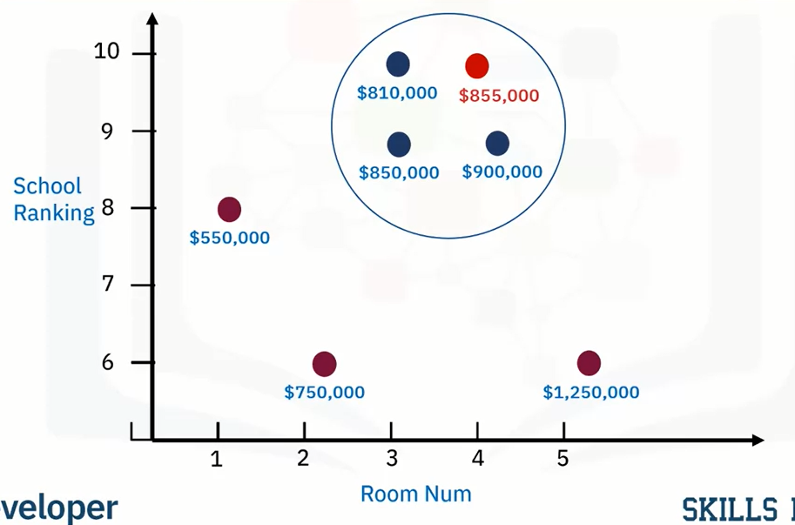
Self-interpretable: K-nearest neighbor

Slide 14
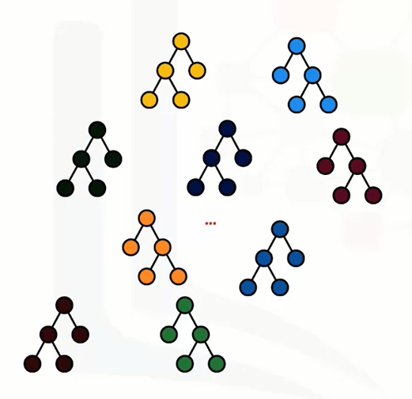
Non-self-interpretable: Ensemble models

Slide 15
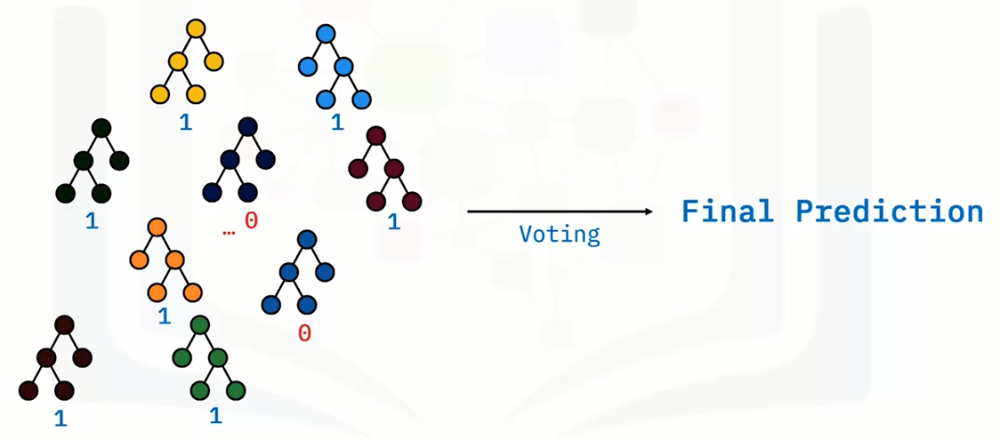
Non-self-interpretable: Ensemble models

Slide 16
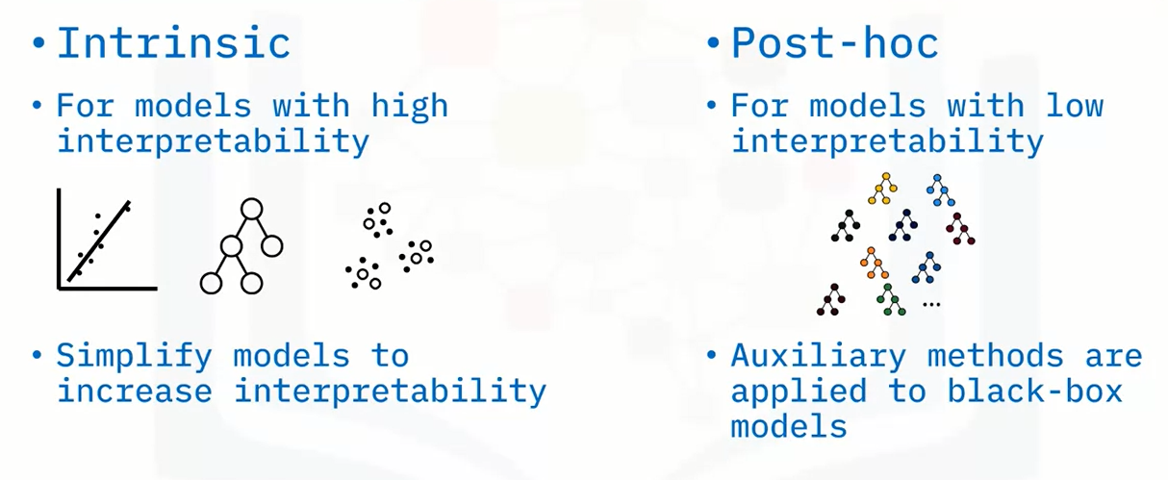
Model interpretation methods

Slide 17
Recap
In this video, you learned that:
• Simple linear, tree, or KNN models are normally self-interpretable
• Complex models such as large ensemble models or SVM are normally non-self-interpretable
• Two types of interpretation methods:
• Intrinsic methods are used with models that are self interpretable
• Post-hoc methods are used to interpret models that are trained with black-box models

Slide 18
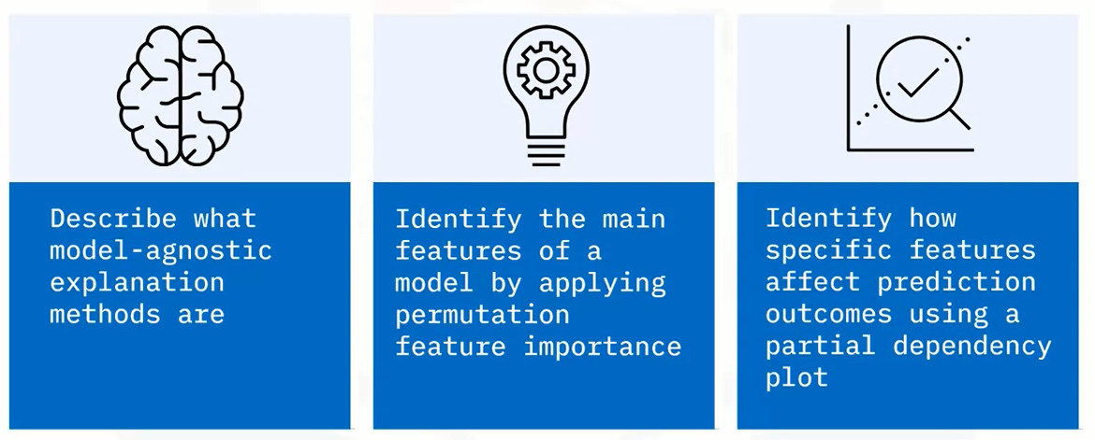
What you will learn

Slide 19
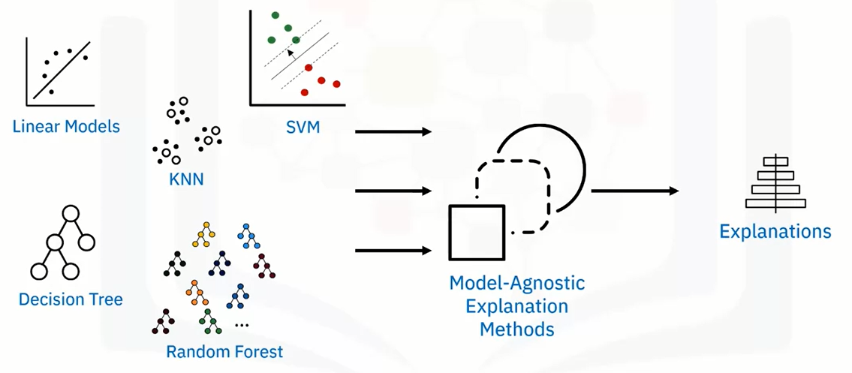
Model-agnostic explanations

Slide 20
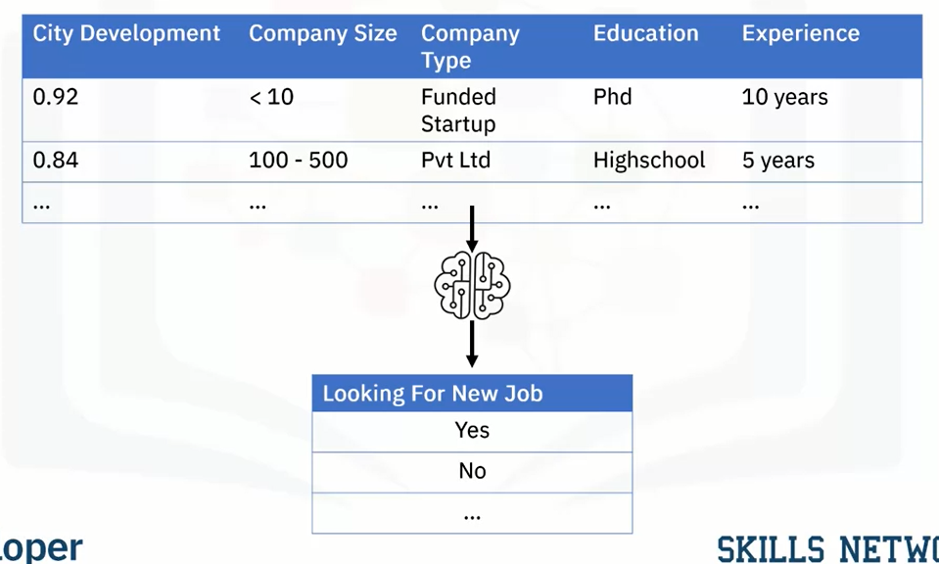
Predicting if employees are looking for a new job

Slide 21
Feature importance
• Measure the importance of features
1. Simplify your model by only including important features
2. Interpret how predictions were made
• Permutation feature importance
• Impurity-based feature importance
• Shapley Additive explanations (SHAP) values

Slide 22
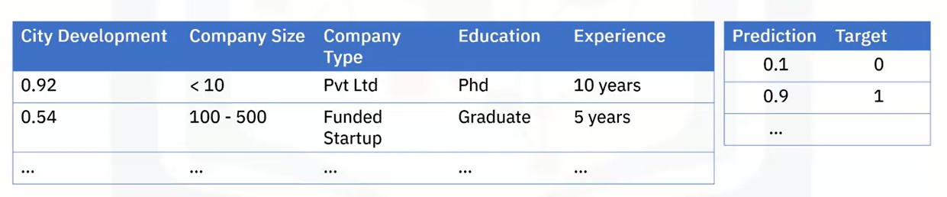
Permutation feature importance
• Measure the increases of prediction errors by permuting/shuffling a feature

Slide 23
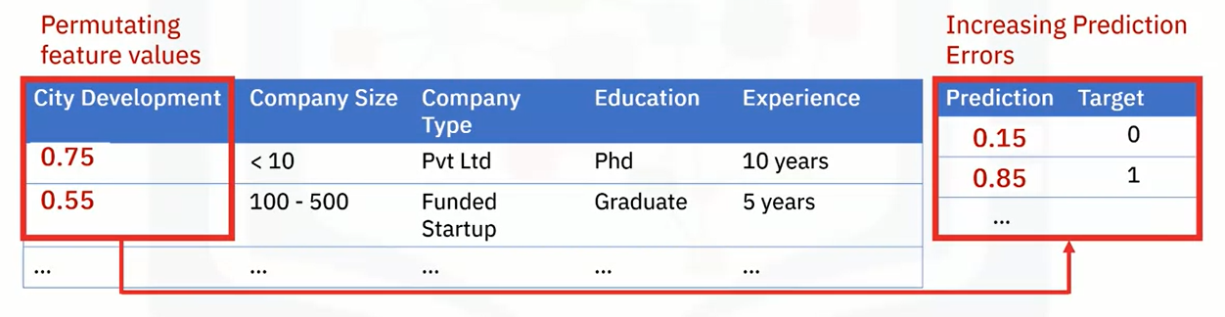
Permutation feature importance
• Measure the increases of prediction errors by permuting/shuffling a feature

Slide 24
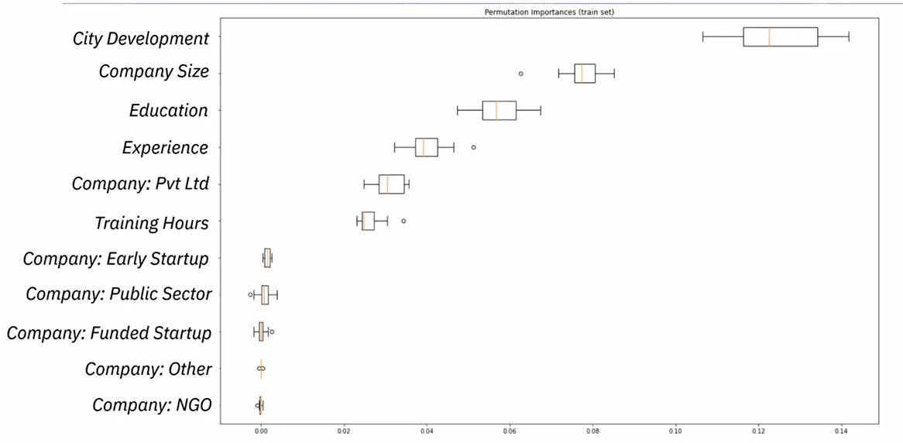
Permutation feature importance example

Slide 25
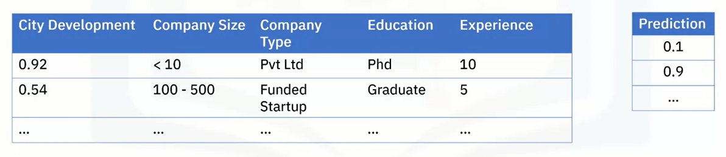
Partial Dependency Plot (PDP)
• Shows the relationship (marginal effects) of interested features on the prediction outcome

Slide 26
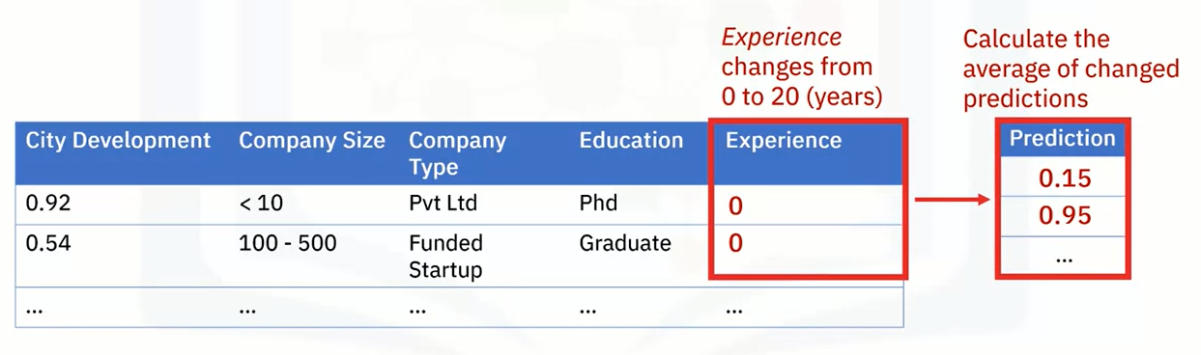
Partial Dependency Plot (PDP)
• Shows the relationship (marginal effects) of interested features on the prediction outcome

Slide 27

Partial Dependency Plot (PDP)
• Shows the relationship (marginal effects) of interested features on the prediction outcome

Slide 28
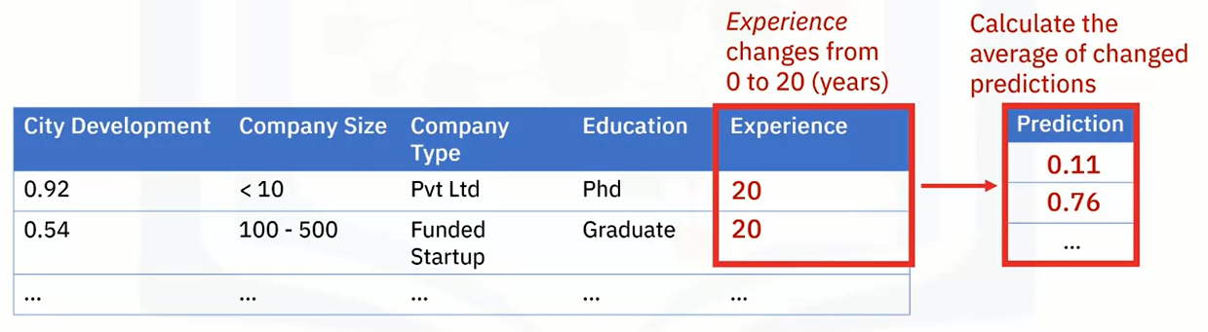
Partial Dependency Plot (PDP)
• Shows the relationship (marginal effects) of interested features on the prediction outcome

Slide 29
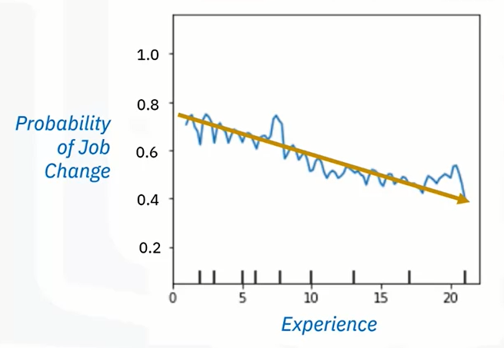
PDP of feature ‘experience’

Slide 30
Recap
In this video, you learned that:
• You can can use model-agnostic explanation methods to understand different models, regardless of their structures
• You can use Permutation Feature Importance to calculate and rank feature importance
• You can illustrate the relationship between an interested feature and model outcome using a Partial Dependency Plot (PDP)

Slide 31
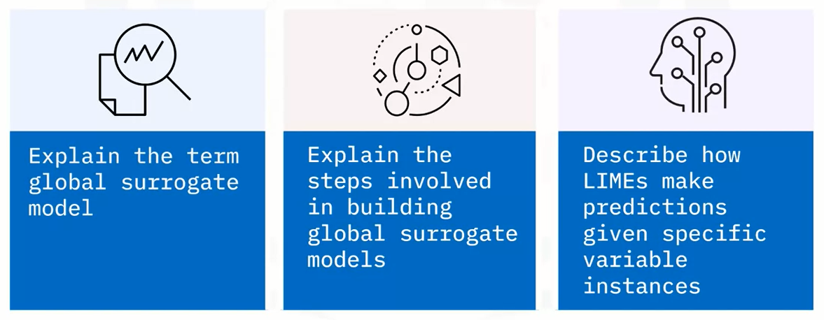
What you will learn

Slide 32
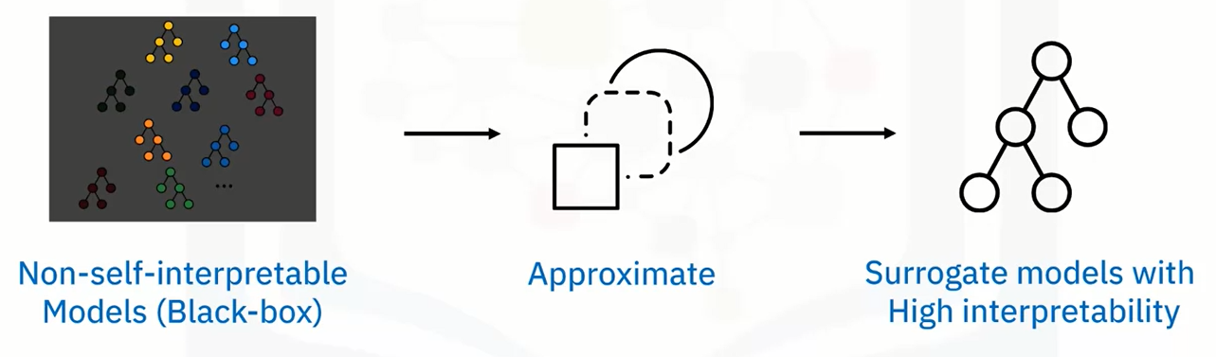
Surrogate models

Slide 33
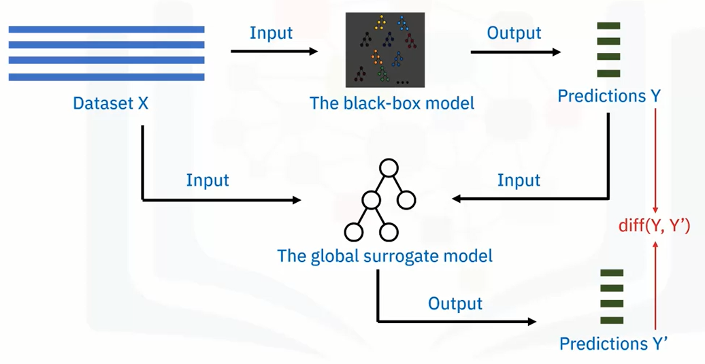
Global surrogate models

Slide 34
Local surrogate
• Global surrogate models may not always work
• Large inconsistency between surrogate models and blackbox models
• Multiple data instance groups or clusters in the dataset
• Explain specific interested data instances locally
• A local surrogate model is built on one or a few instances

Slide 35
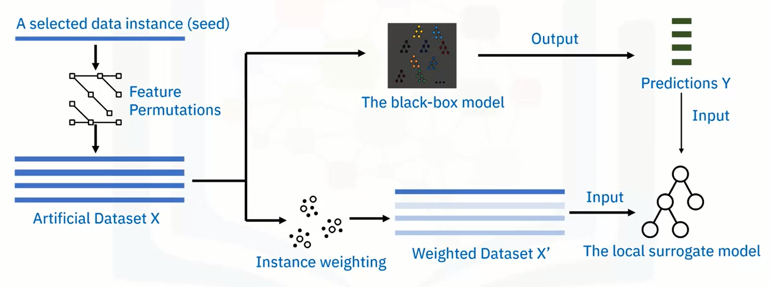
Local Interpretable Model-Agnostic Explanations (LIME)

Slide 36
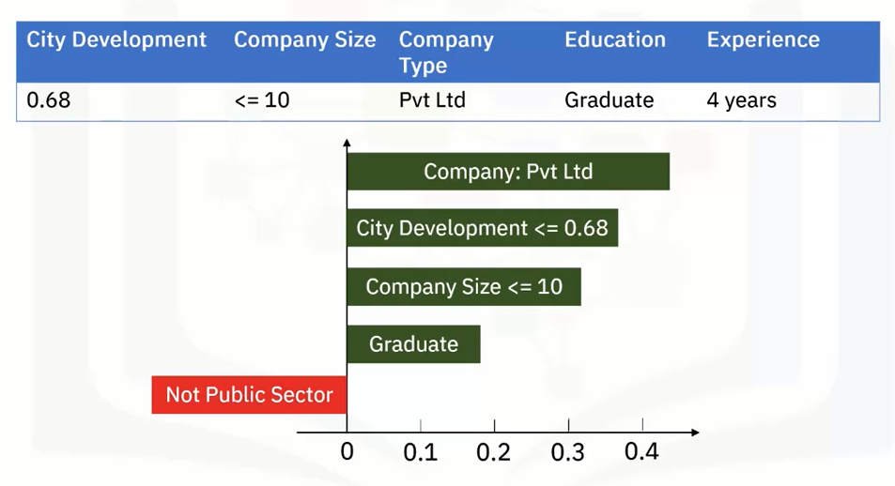
A LIME example

Slide 37
Summary
Modeling Unbalanced Classes
Classification algorithms are built to optimize accuracy, which makes it challenging to create a model when there is not a balance across the number of observations of different classes. Common methods to approach balancing the classes are:
Downsampling or removing observations from the most common class
Upsampling or duplicating observations from the rarest class or classes
A mix of downsampling and upsampling

Slide 38
Learning Recap
In this section, we learned that:
• A surrogate model is a way of explaining complex black box models using simpler models
• The general steps to build global surrogate models are straightforward
• You can build local surrogate models using the LIME algorithm

